Slide 1



SMART TRAFFIC MANAGEMENT
By Alex Gyawali

Slide 2


TABLE OF CONTENTS
Introduction
Why use technology
Problems
Process of building
Additional features
Benifits
Steps
Challenges
Solution
References
01
02
03
04
05
06
07
08
09
10

Slide 3

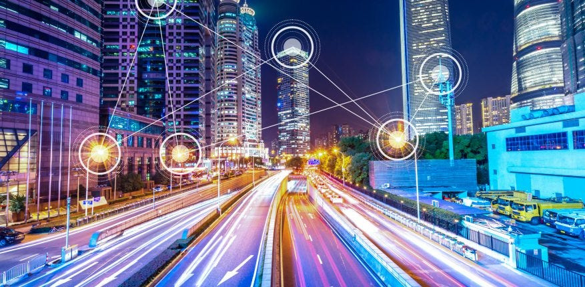
INTRODUCTION
Smart Traffic Management
Smart traffic managent is a method of using upcoming technology and iot devices and using them in reducing traffic jams on the roads and keeping a steady continuos flow of vehicles without a huge waiting time

Slide 4
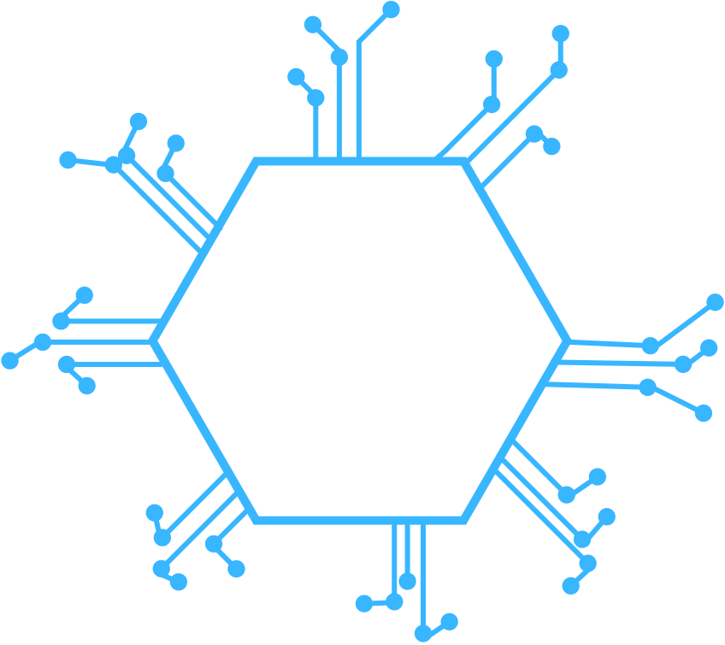

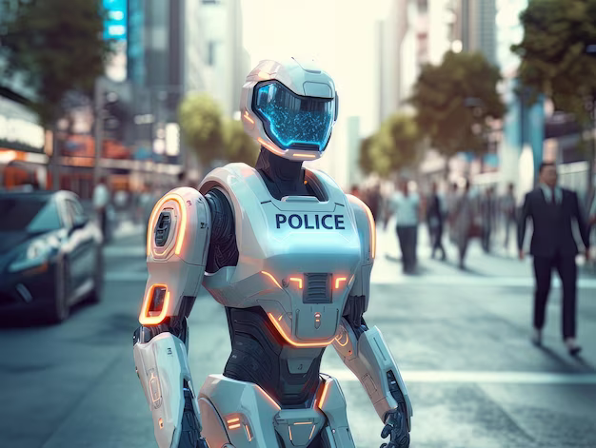
WHY USE TECHNOLOGY?
- Lack of human resources
- Improper management skills
- Reduction of human labor
- Large density of vehicles
- Human limitations

Slide 5

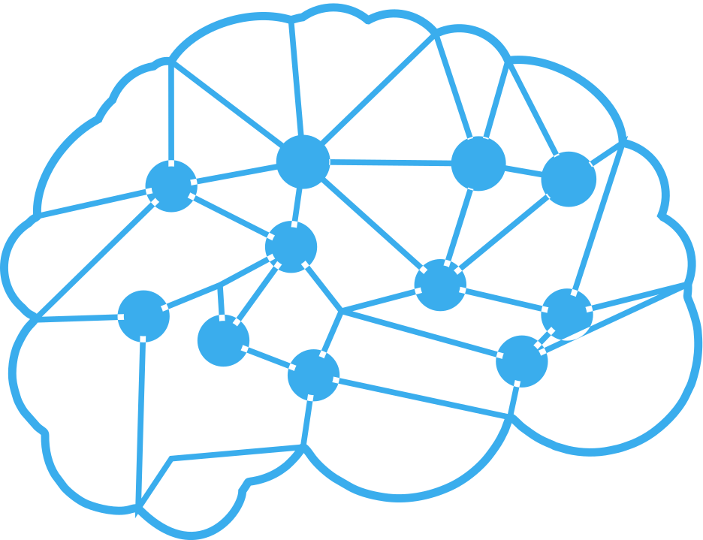
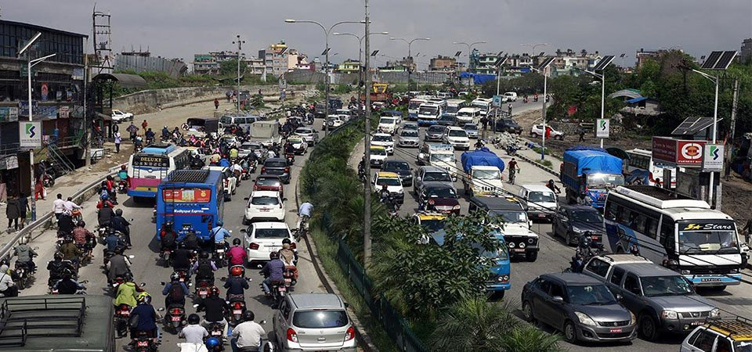
Problem in society
Everybody is in a rush to go somewhere
A lone human traffic police mind can only process so much data at once
Some people are in such a hurry they over speed and crash

Slide 6

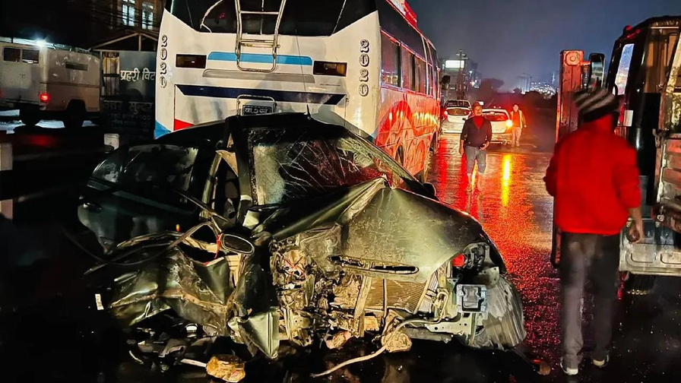
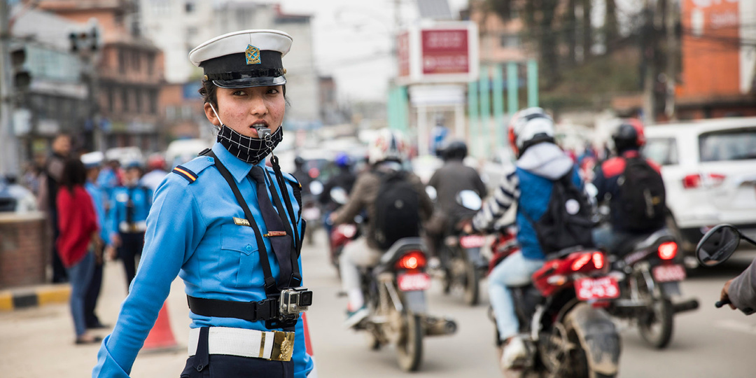

Traffic and Accidents
People driving in a rush cause accients
A lone person can easily be overwhelmed
with overflow of information
Allowing traffic to flow at a steady rate keeps everyone safe and happy
Also reduces instances of road rage

Slide 7






PROCESS OF BUILDING THE SYSTEM
COMPUTER PROCESSING
DEPLOY SENSORS
DATA STORAGE
TRAFFIC CONTROL
Deploy multiple sensors through out the road to covers the whole road
Once the data has been collected in real time , it needs to be stored in a server or cloud platform
The computer process the information in the platform in real time , decodes a pattern and decides an algorithm
After coming up with a solution, the computer then controls the traffic lights and manages the flow

Slide 8



ADDITIONAL FEATURES
01
02
03
04
Emergency Vehicle Detection
VIP Vehicle
Detection
Over Speeding Detechtion
Crash Site Detection
The computer also actively
scans the road for accidents
and if detected calls the
authoorities
We teach the computer
to give special priority to
emergency vehicles.
In addition we also
teach the computer to
recognize high priority figures.
The computer
recognizes over speeding
vehicles and fines the owner
of the vehicle.

Slide 9


Benifits
1
5
Reduce Human labor
Reduction of accidents
2
6
Fast decision making
On time arrival to destination
3
7
Constantly active
Friendly and reliable User Interface
4
Continuous machine learning

Slide 10

Steps
Step 3
Step 5
Step 1
Data process
and management
Data visualization
and decision making
Data Aquisition
Step 2
Step 4
Data analyzation
Data Transmission

Slide 11

Data acquisition
1
2
3
High speed camera mixed with machine learning
Ultrasonic Sensors
PIR
Detect the presence of vehicles standing
and waiting in lines
Detect the denisty of vehicles traveling
down the road
Capture images of vehicles over speeding and accidents as well

Slide 12
Data transmission
1
2
3
Mode of transmission
Devices
Destination
Wi-Fi , Bluetooth, Fiber Optics
Ethernet cable , Satalite , Radioi Waves
Rasberry - Pi , Arduinos , Micro computers
Main serve or cloud platform storage device

Slide 13
Data processing and managemenyt
2
1
AI and machine learning
Cloud storage
Infrastructure : Uses hosting platforms such as google cloud server or aws or azure
Servers: Oracle or MySQL
Use of Ai and computers to organize , seperate and decode the data

Slide 14
Data analyzing
1
Detect vehicle densitiy
2
3
Accident detection
VIP detection
Computer searches for images and data that resembles crashes
Scan and detect high priority vehicels
Computer scours through hundreds of sensor data and detects large amounts of
vehicle traffic

Slide 15
data visualization and decision making
1
2
Traffic control
Speeding fine
3
Crash detection
compute the best suitable algorithm for dispersing traffic quickly and the device controls the traffic lights
Capture images of high speeding vehicles and fine them for breaking the law
Scour through all the sensr data captured and images for crash detections and alert the proper authorities
4
5
User interface app
High priority vehicle
Detect high priority vehicles like ambulances or military or vip personel vehicles stuck in traffic and clear the road for them
Develop a user friendly app that constantly gives real time data of traffic density and crashes on the road and suggest the best route to go around it

Slide 16
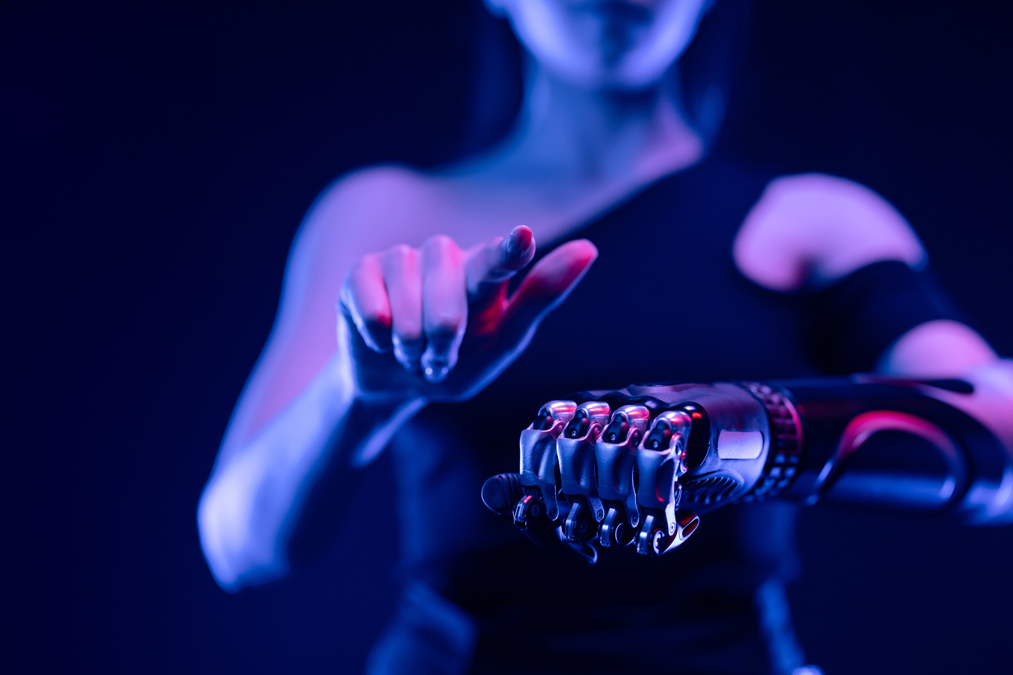



CHALLENGES
Device Cost
Device Maintainence
Errors and miscalculations
Data transmission faliure
Security risks to VIP

Slide 17

SOLUTIONS
-> Consider the change as a one time investment
-> Do mandatory inspections and minor maintainence
-> Constantly update and check codes for bugs and errors
-> Keep providing updates for the app

Slide 18
SOLUTIONS
-> Buy High quality components from reliable vendors
-> Add a user app feedback option for application
improvement
-> Creation and Use of a powerful firewall
-> Keep providing updates for the app

Slide 19


REFERENCES AND LINKS
Here , the links for all the image sources for the pictures that have been used in this presentation
https://medium.com/@anoopvidyadharan6/intelligent-traffic-management-system-itms-dec9a8fcca9a
https://www.spotlightnepal.com/2022/01/06/why-traffic-jam-kathmandu-notorious/
https://www.nepallivetoday.com/2022/01/04/nepal-sees-a-staggering-spike-in-road-crashes/
https://www.alamy.com/stock-photo/kathmandu-traffic.html?sortBy=relevant
https://www.freepik.com/premium-ai-image/busy-city-street-humanoid-robot-police-uniform-is-directing-traffic-monitoring-pedestrians-generative-ai_46158083.htm
This presentation has been created via the help of a presentation tool , Canva

Slide 20


THANK YOU!

